Slide 1

Group5
STUXNET
ADVANCED MAN-IN-THE-MIDDLE ATTACK ON INDUSTRIAL CONTROL SYSTEMS
Aaryan Sharma - 16010123012
Aditey Kshirsagar - 16010123017
Aditya Baheti - 16010123023
Amandeep Singh - 16010123036
Ambuj Rai - 16010123037

Slide 2


SIMULATION

Slide 3



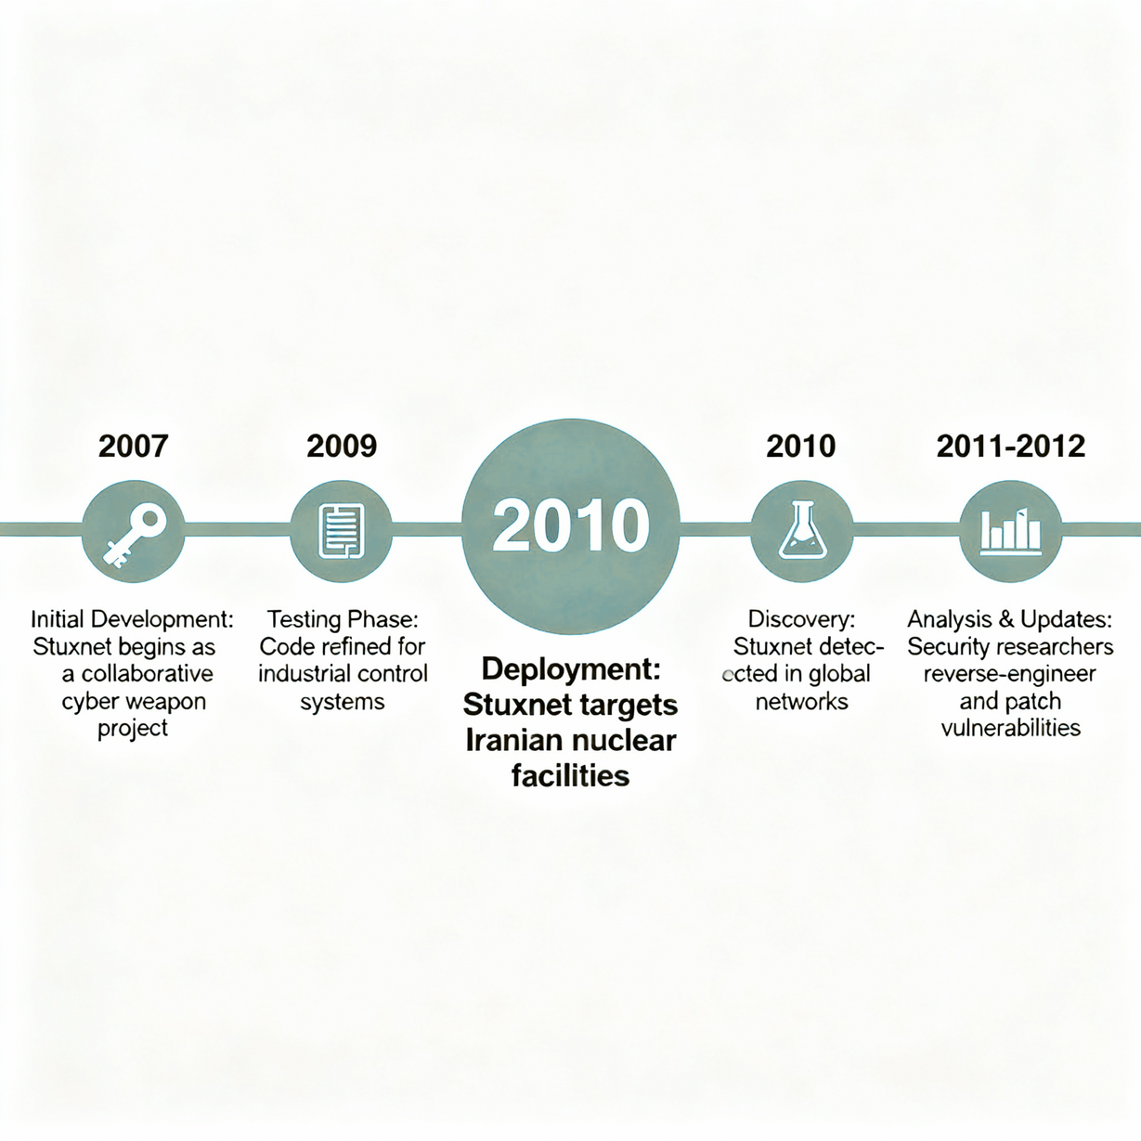
ATTACK OVERVIEW & TIMELINE
What Was Stuxnet?
Target: Iran's Natanz nuclear enrichment facility
Discovery: June 17, 2010 by VirusBlokAda (Belarus)
Attribution: U.S.-Israeli "Operation Olympic Games"

Slide 4
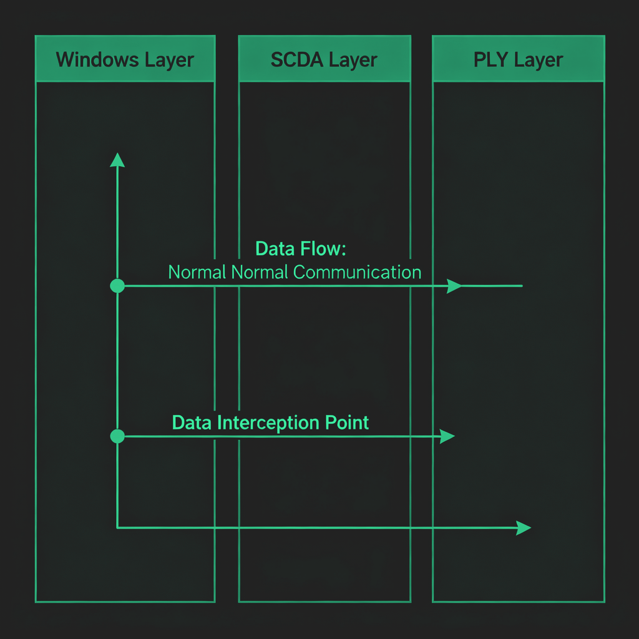
THE MITM ATTACK ARCHITECTURE
Three-Layer Interception Strategy
1. Windows Layer: 4 zero-day exploits + stolen certificates
2. SCADA Layer: Siemens Step7/WinCC software compromise
3. PLC Layer: Hardware controller manipulation

Slide 5

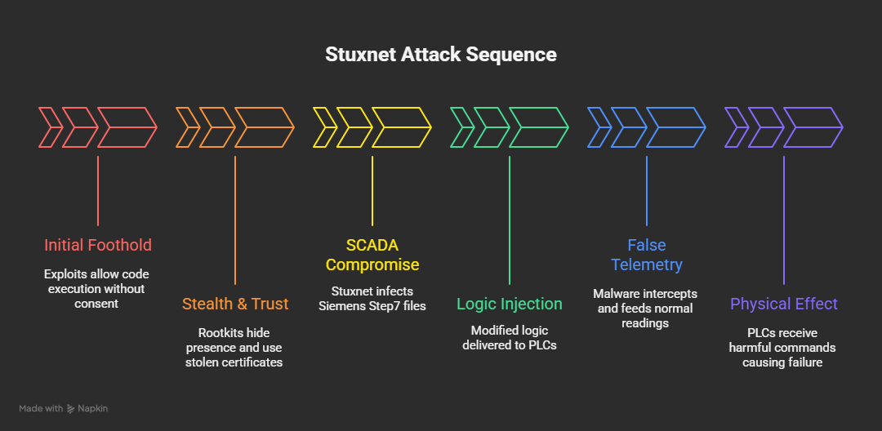
TECHNICAL MECHANISM
Attack Sequence:Initial foothold — multiple Windows zero-day exploits let code run without user consent.
Stealth & trust — kernel-level rootkits hid presence; stolen certificates made components appear signed.
SCADA compromise — Stuxnet infected Siemens Step7 project files and engineering tools.
Logic injection — modified ladder logic / function blocks were delivered to specific PLCs.
False telemetry — malware intercepted/read sensor values and fed operators normal readings.
Physical effect — PLCs received harmful timing/speed commands → mechanical stress and failure.

Slide 6
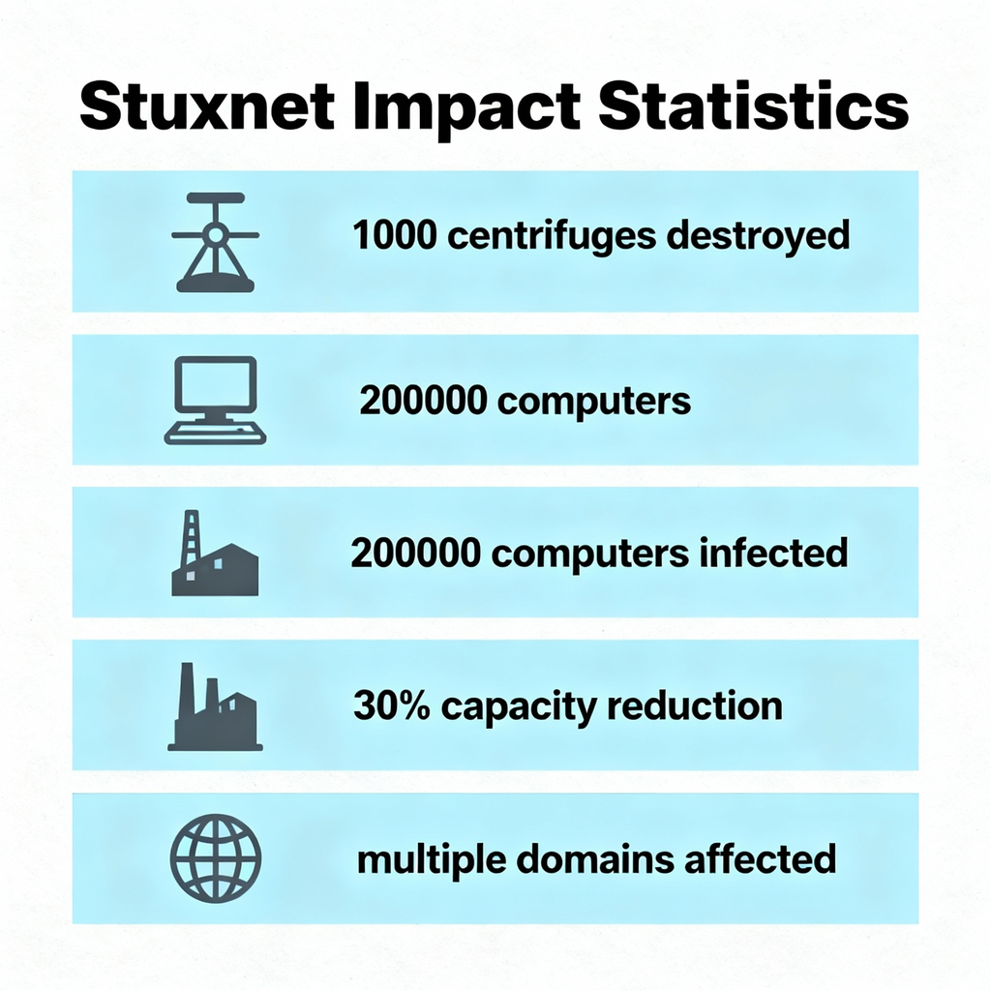
IMPACT ASSESSMENT
Unprecedented Damage Across Multiple Domains
Physical Impact:
- 1,000 centrifuges destroyed/replaced
- Significant delays to nuclear program
- First software-caused physical destruction
Global Security Impact:
- New cyber warfare paradigm
- Exposed critical infrastructure vulnerabilities
- Changed threat landscape permanently
Economic Impact:
- Millions in equipment replacement costs
- Massive global security investment increases

Slide 7
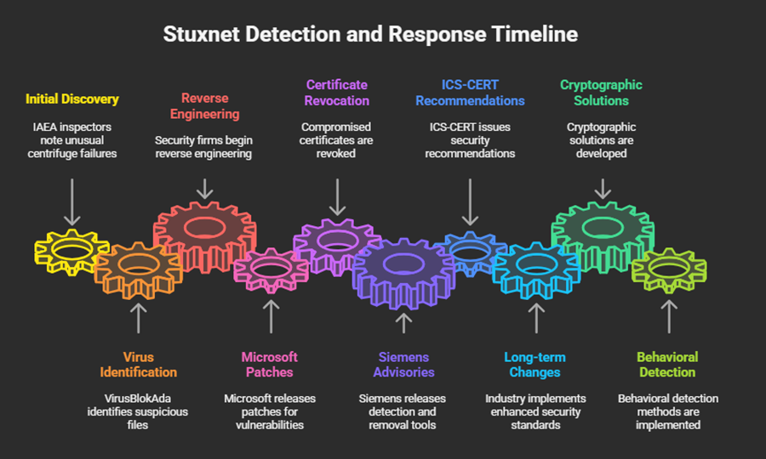
DETECTION CHALLENGES & RESPONSE
Detection Challenges:
- Kernel-level rootkit concealment
- Legitimate digital certificates
- Targeted behavior (dormant on non-targets)
- Air-gapped environment assumptions
Industry Response:
- Microsoft patched all 4 zero-days (Feb 2011)
- Siemens released detection/removal tools
- ICS-CERT issued comprehensive advisories
- Enhanced industrial security standards
Why It Remained Hidden for 3 Years

Slide 8

LESSONS LEARNED & DEFENSE STRATEGIES
Defense Recommendations:
1. Defense in Depth: Multiple security layers
2. Network Segmentation: IT/OT separation
3. Behavioral Monitoring: Physics-based detection
4. Cryptographic Integrity: Authenticated commands
5. Incident Response: ICS-specific procedures
Strategic Lessons:
- Air gaps are insufficient protection
- Supply chain vulnerabilities critical
- Insider access vectors remain viable

Slide 9
CONCLUSION & CURRENT RELEVANCE
Stuxnet forever changed cybersecurity by proving software can inflict real-world damage. Its precision MITM attack on industrial control systems exposed critical vulnerabilities in “air-gapped” networks and reshaped how we defend critical infrastructure. As threats evolve, implementing defense-in-depth, real-time monitoring, and zero-trust principles is no longer optional, it’s essential.

Slide 10

THANK YOU

